Slide 1
Products
2016 Product training

Slide 2
Scimetrics Ltd Corp
The Science Behind the Bait
Richard Poche, president/owner of Scimetrics Ltd and Genesis Labs, is a world renowned biologist and humanitarian
Over 100 combined years of experience in rodent control & product formulation
Hundreds of studies/projects completed for Federal and State Agencies, as well as for private companies
Work and research in well over 60 countries
First and ONLY company in the world to add insecticides to bait to help combat flea-borne illnesses
Family-Owned and American Made
Notes:
Company location, describe facilities
Richards history with liphatech
Focus on reducing secondary kill
Genesis labs – epa registrations
India, kenya, cdc
New insecticide Fipronil

Slide 3
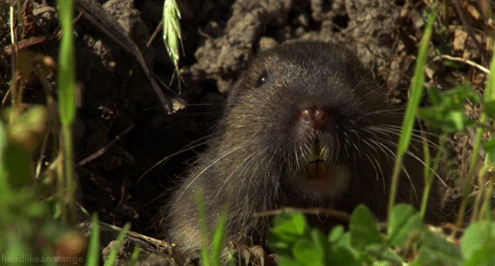
Pocket Gophers
Kaput-d pocket gopher bait
Kaput-D Burrow builder pocket gopher bait (RUP)
Notes:
60% of business
Driving states: TX, NV
Private label in CA

Slide 4
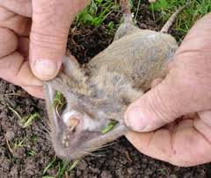
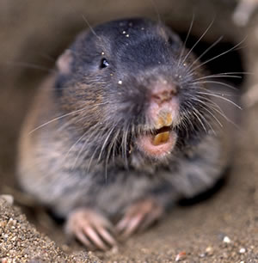
Characteristics:
Large fur-lined cheek pouches, from which their name derives
Small eyes and short hairy tail used to feel around tunnel when walking backwards
Large front claws and large incisors (always exposed), both used for digging
Gophers weigh around ½ lb, and are about 6–8 inches long, with a tail 1–2 inches (25–51 mm) long
Usually one litter of 2-6 per spring, beginning the spring after birth
Feed on roots, plants and other vegetation found while digging, at tunnel entrance, or pulled in from below.
Almost completely subterranean existence
Solitary except to mate and when raising young

Slide 5
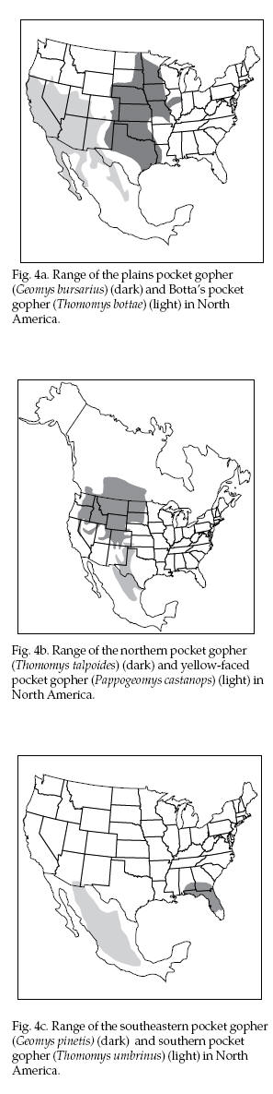
RANGE
Plains Pocket Gopher (Geomys bursarius)
Botta’s Pocket Gopher (Thomomys bottae)
Northern Pocket Gopher (Thomomys talpoides)
Yellow-Faced Pocket Gopher (Pappogeomys castanops)
Southeastern Pocket Gopher (Geomys pinetis)
Southern Pocket Gopher (Thomomys umbrinus)

Slide 6
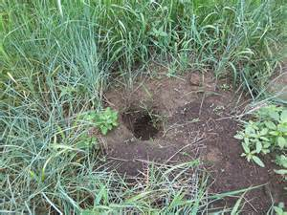
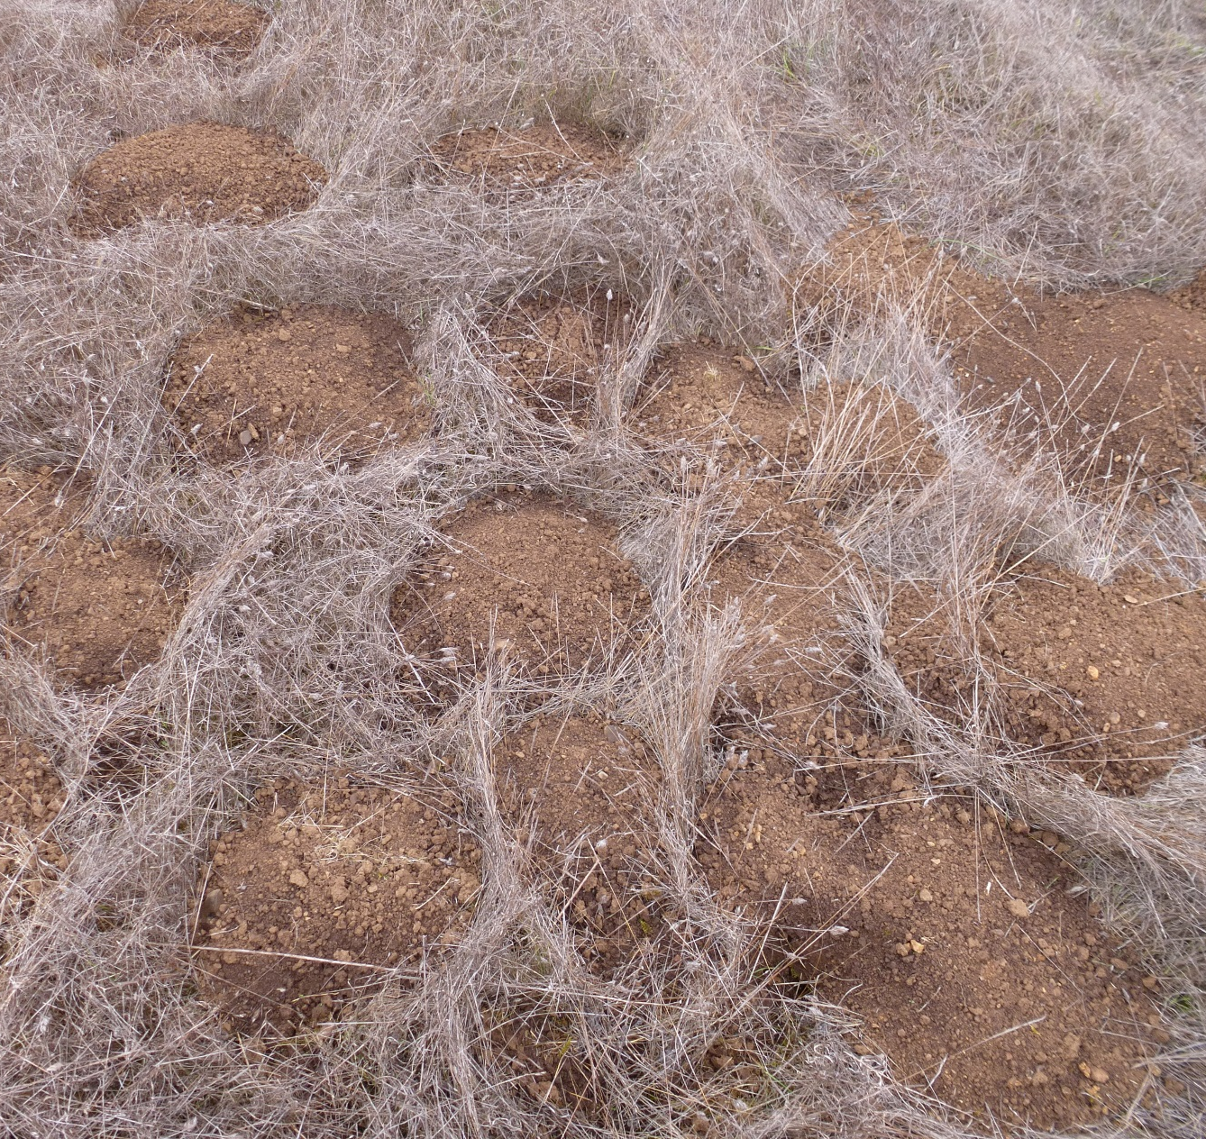
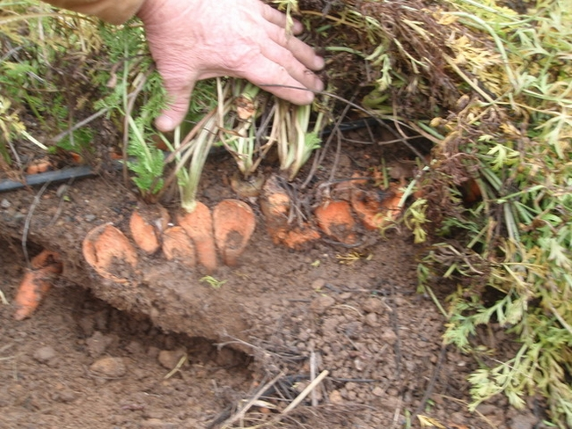
Damage
Up to 60 gophers per acre in irrigated fields
1 gopher can construct 300 mounds in a year and move 4 tons of soil
Fan-shaped soil mounds
Reduced rangeland forage yields of 21-49% reported¹
30% loss reported for hay meadows¹
Can damage plastic water lines and irrigation systems
Injuries to people & livestock from tripping on or stepping in gopher mounds & holes
Notes:
1 – source: Internet Center for Wildlife Damage Mgmt (Case, Univ of NE)

Slide 7
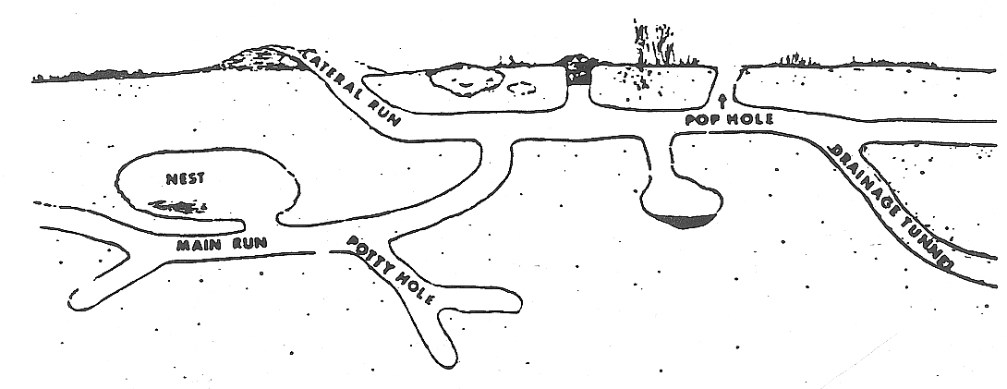
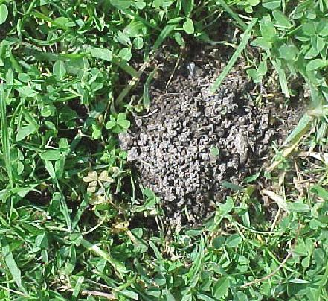
Tunnel / Burrow System
Earthen filled pop hole with signs of
gopher feeding around perimeter
Burrow system of anywhere from 200 to 2000 square feet
Tunnels are 2” to 4” in diameter and can be quite extensive
Depending on time of year, main tunnel can be 3” – 18” below surface
Lateral runs used to push loose dirt out of system, creating fan shaped mounds
‘Pop holes’ lead straight up to the surface from the main run and are used as access to foliage growing closely to the opening
Drainage tunnels, a nesting area and food storage areas are also present
Notes:
Next slide:
So lets talk about the right way and the wrong way to bait for gophers
Here are some examples of the wrong way

Slide 8
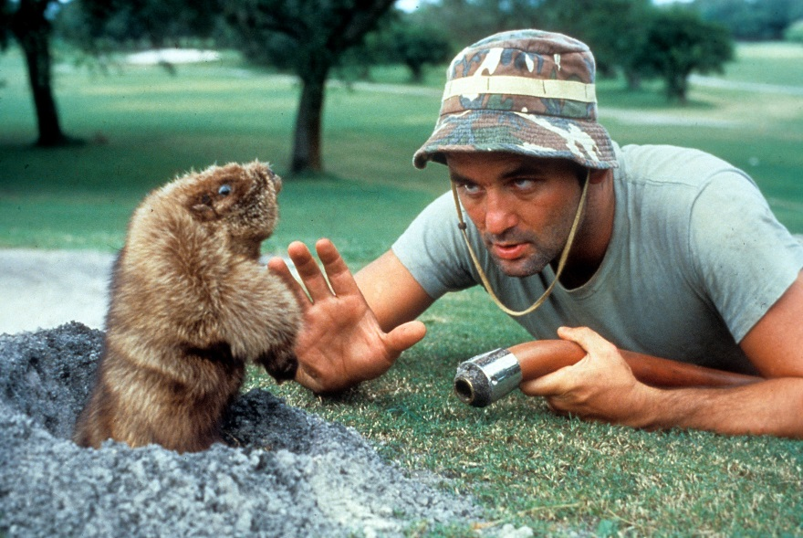
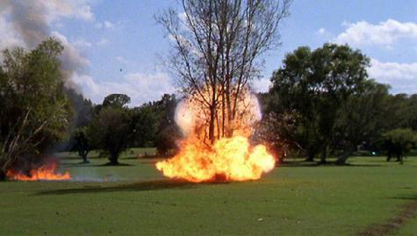
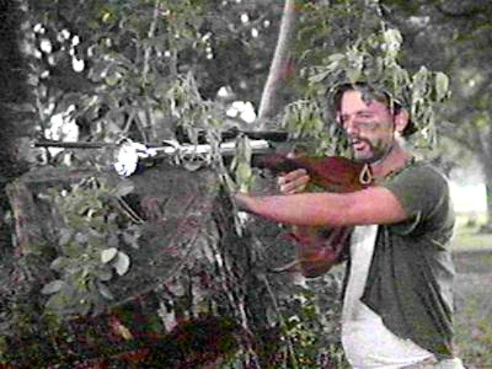
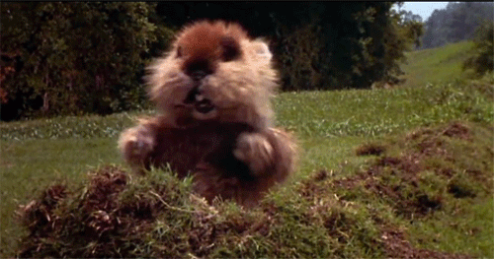
FLOODING
EXPLOSIVES
GUNS
Notes:
So while we are having some fun, how about some Caddyshack trivia?
1. What was Bill Murray’s name? Carl Sparkler
2. What was the theme song? I’m alright by Kenny Loggins
3. What type of candy bar was used in the pool scene? Baby Ruth
Next slide:
Let’s talk about the most common baits on the market

Slide 9
Common Bait Types
Kaput-D
Diphacinone
Rozol
Wilco #1
Zinc Phosphide
NO Antidote
Martins
Strychnine
Milo only
Antidote – Vit. K1
Wheat or Milo
Chlorophacinone
Antidote – Vit. K1
Wheat only
Milo only
NO Antidote
1st Gen. anti-coag
1st Gen. anti-coag
Acute
Acute
Amount a 50lb dog would need to eat to attain mortality:
Diphacinone
1.4lbs
Zinc Phosphide
1.7oz
Strychnine
0.5oz
Chlorophacinone
8oz
Notes:
Explain anti-coagulants
Acute Toxicity = Any poisonous effect produced from a single or short exposure (24 to 96 hours) resulting in severe biological harm or death
Next slide:
Lets talk more about Kaput gopher bait

Slide 10
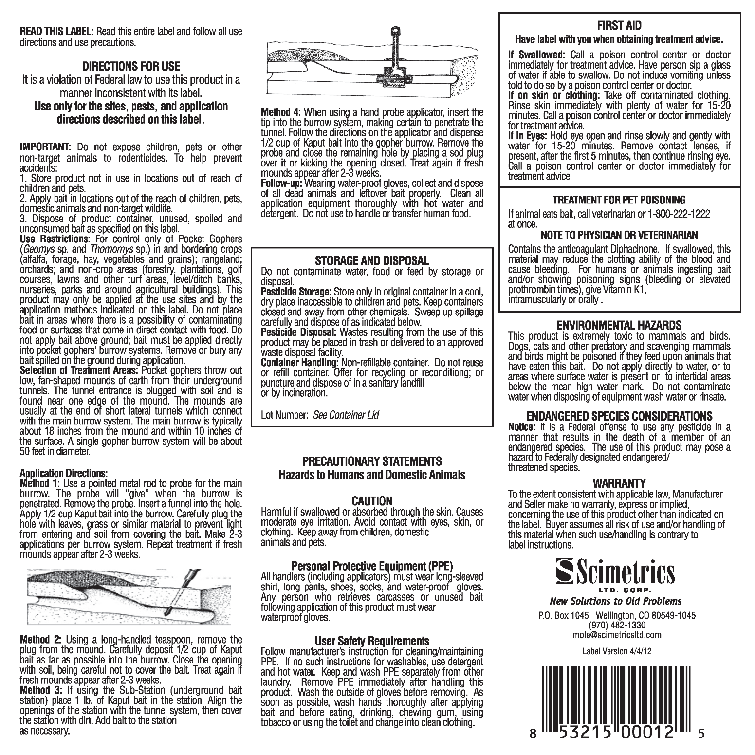
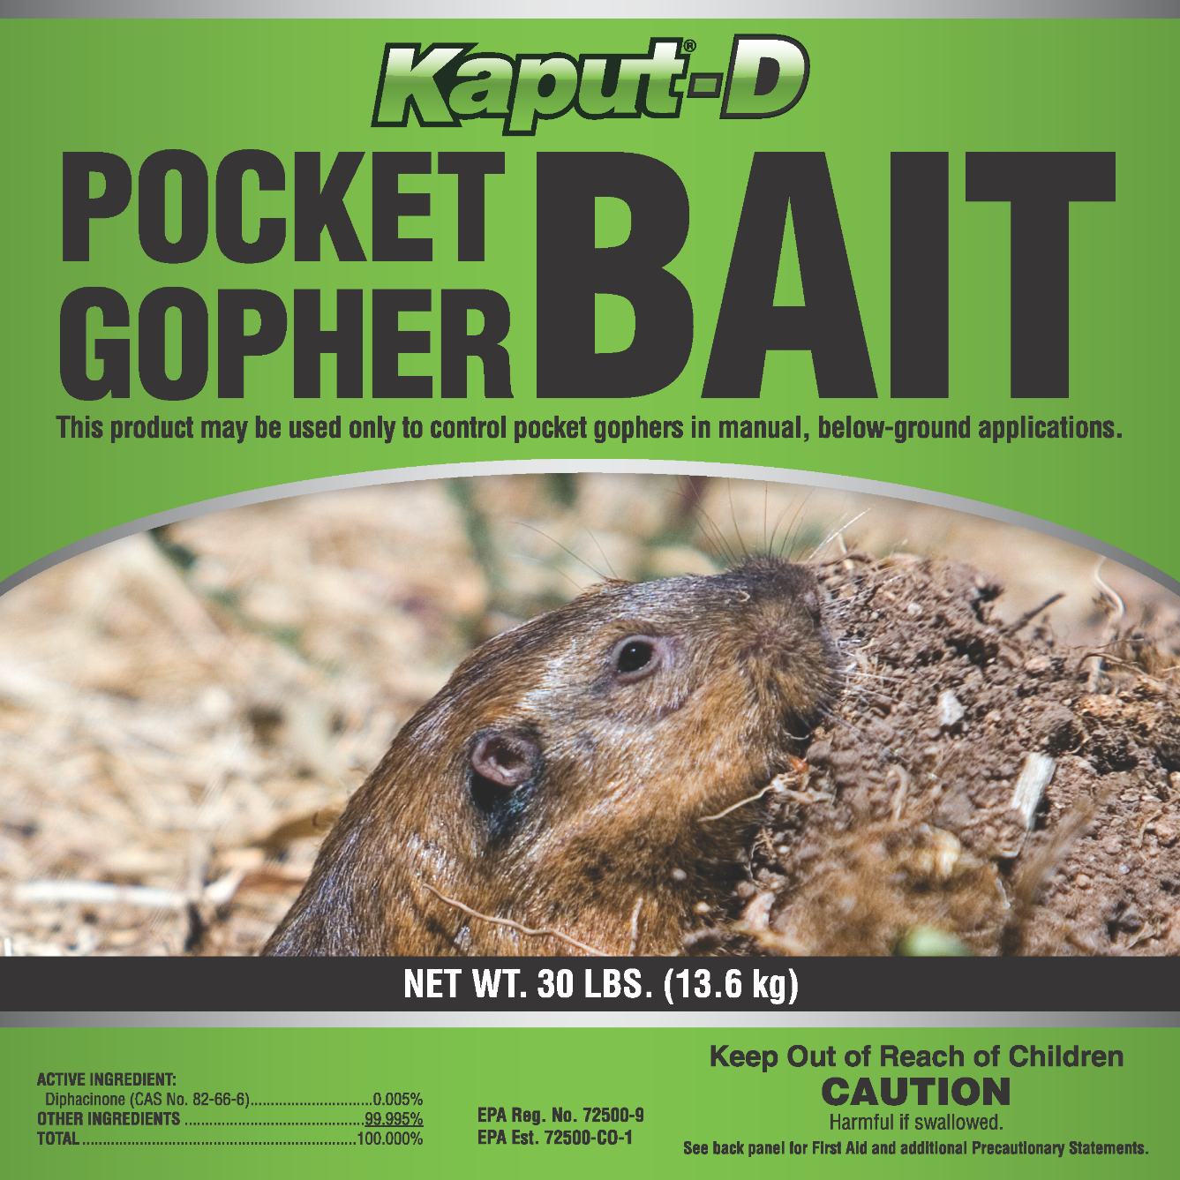
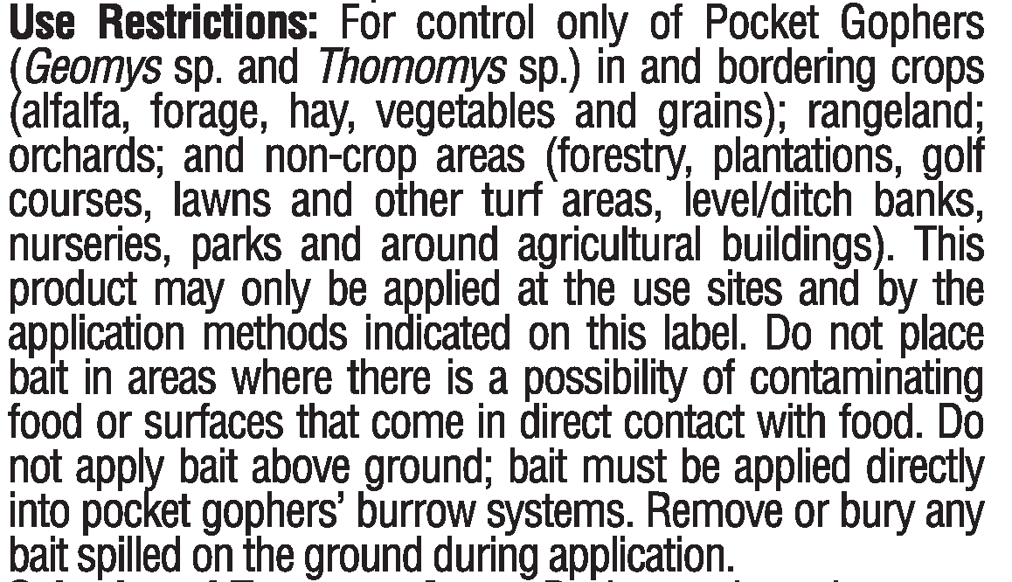
Notes:
Non-restricted
Restricted
Sizes
Zoom to use restrictions
Next slide:
How to bait with non-RUP

Slide 11
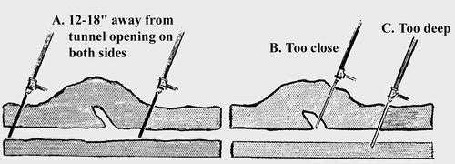
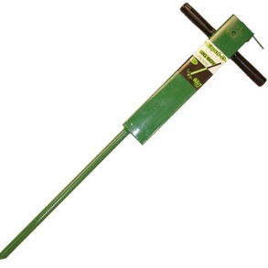
Application Methods
Probe with metal rod to find runways, then use a funnel to apply ½ cup bait directly into runway. Cover opening.
Remove plug from mound and use long handled spoon to apply ½ cup bait as far into opening as possible. Re-cover plug when done.
Using underground bait station, apply 1 lb of bait and align station openings with tunnel. Cover with dirt.
Insert gopher probe 12-18” from tunnel openings to find runways and then apply ½ cup bait into runway. Cover opening.
Before applying bait, identify active holes
Kaput-D ‘Big Boy’
Pocket Gopher Bait Probe/Applicator
Notes:
The label allows for baiting the hole itself, however we do not recommend that
Will will be doing a demonstration at the warehouse today and we have extra probes for you to try out as well
Next slide:
How to bait with RUP

Slide 12
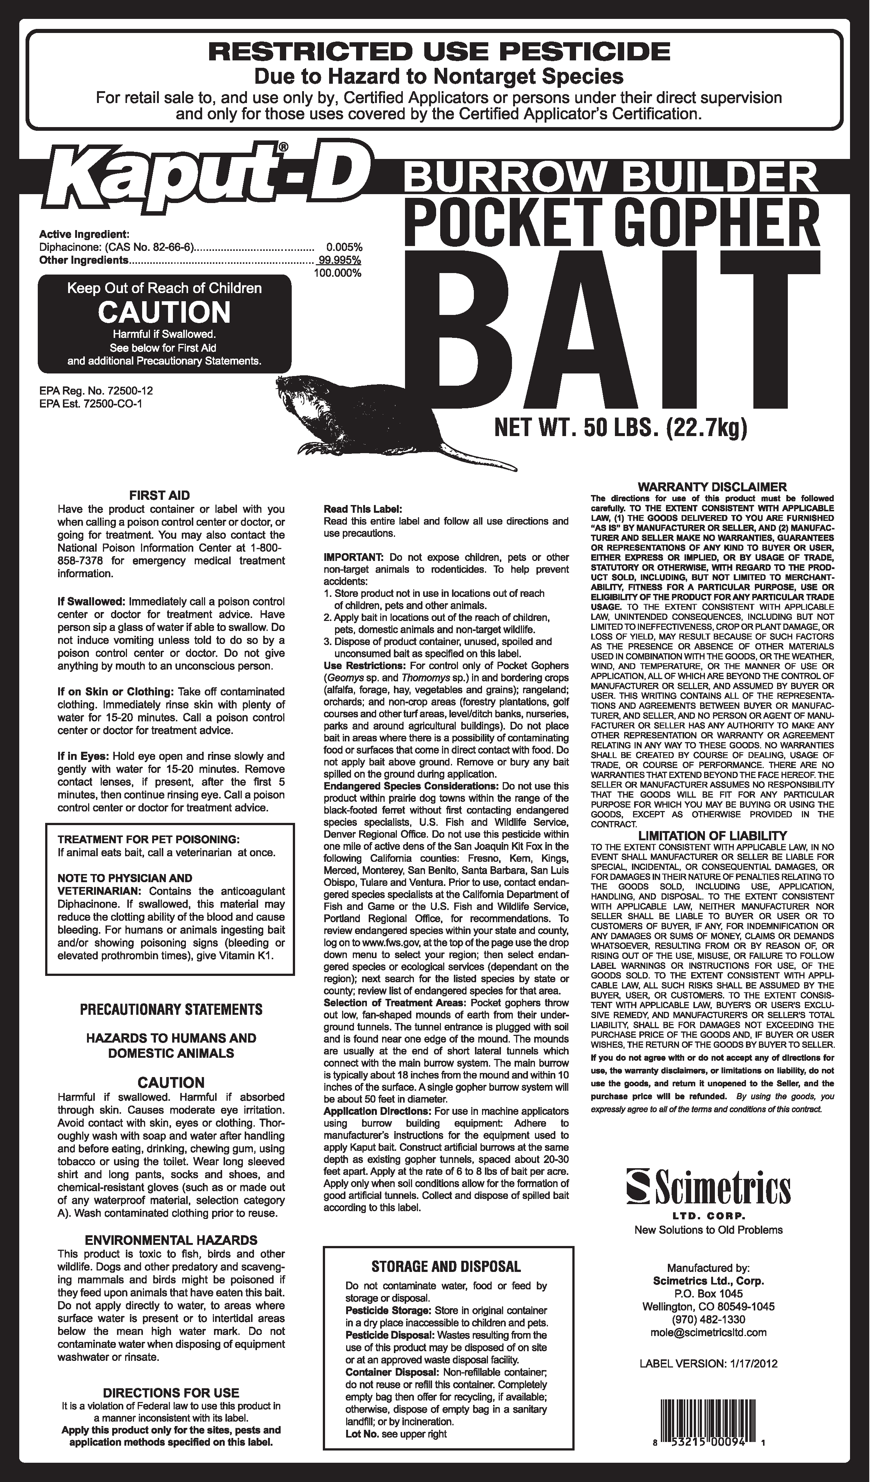
Kaput-D Burrow Builder (RUP)
Restricted Use Pesticide. For use in machine applicators, using burrow-building equipment
Construct artificial burrows at the same depth as existing gopher tunnels
Apply at the rate of 6 – 8 lbs of bait per acre
Apply only when soil conditions allow for the formation of good artificial tunnels
Collect and dispose of spilled bait according to label
Notes:
Next slide:
Some examples of burrow builders

Slide 13

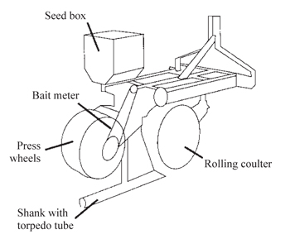
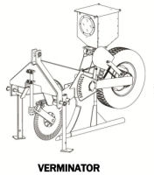
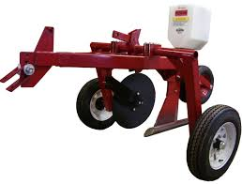
Burrow Builder Machines
Gopher Getter
Notes:
Capacity – Verminator holds over 10 gallons of bait
We will be seeing one of these at the warehouse today
Next slide:
We will talk about how to use a burrow builder

Slide 14
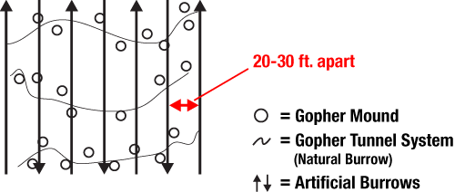
Burrow Builder Use
Set torpedo tubes parallel or tipped slightly downward to soil surface to bite into the soil
Set meter for 6 – 8 lbs of bait per acre
Operate the depth of the tube at the same depth as pocket gopher burrows (add weight if necessary to allow shank to penetrate ground to correct depth)
Make test run to be sure a clean, open tunnel has been created
Pull the machine across rows of mounds to intercept as many burrows as possible. Space rows 20 – 30 ft apart.
Notes:
An acre = A square enclosing one acre is approx. 208 feet 9 inches per side
Next slide:
So now lets talk about prairie dogs

Slide 15
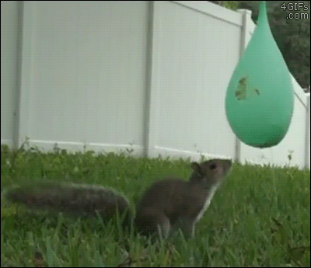
CA Ground Squirrel
Kaput Ground squirrel bait
Kaput-D Ground Squirrel bait (RUP)

Slide 16
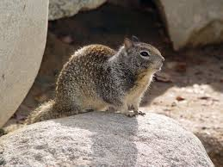
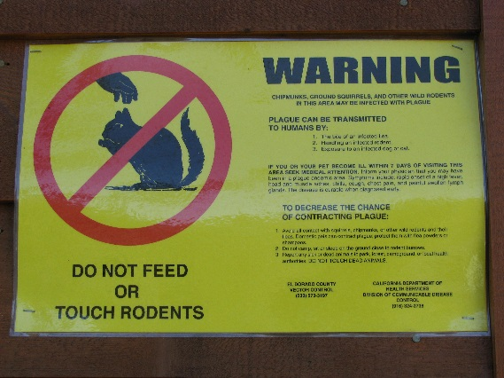
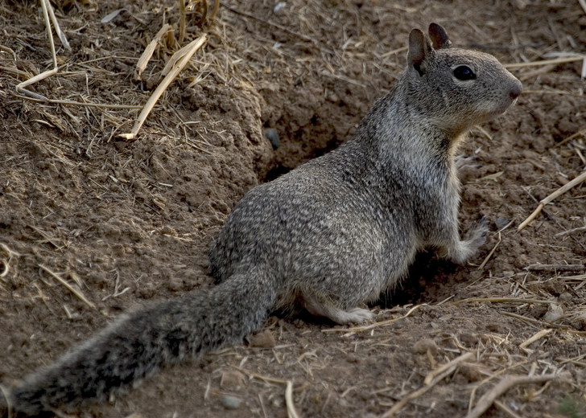
Characteristics:
Fur is mottled mixture of gray and light brown, underside is lighter. Fur around eyes is white and around ears is black
16-19” total length, 5-7” of which is the long furry tail
Lifespan of up to 6 years in the wild
Commonly feed on seeds (oats, acorns, etc), but also eat some insects and various fruits
In colder parts of range they hibernate for several months. Where winter is mild they can be active year round
One litter of 3-15 pups in spring, but 5-6 is average
Spend most of their time within 100 ft of their burrow
Susceptible to bubonic plague
Notes:
Next slide:
So where do you find these?

Slide 17
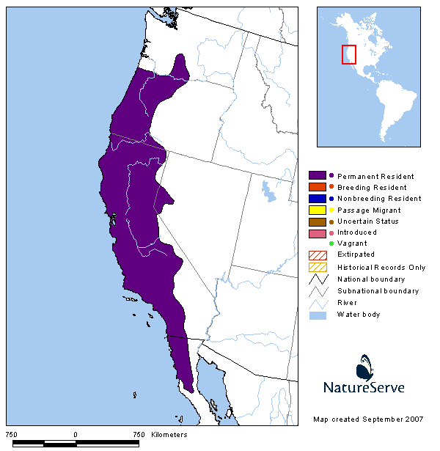
RANGE
CA Ground Squirrels are found in 5 states: CA, NV, OR, WA and more recently have spread to AZ
Range extends down into the Baja California Peninsula
Notes:
Next slide:
Lets see some damage these guys do

Slide 18
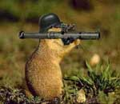
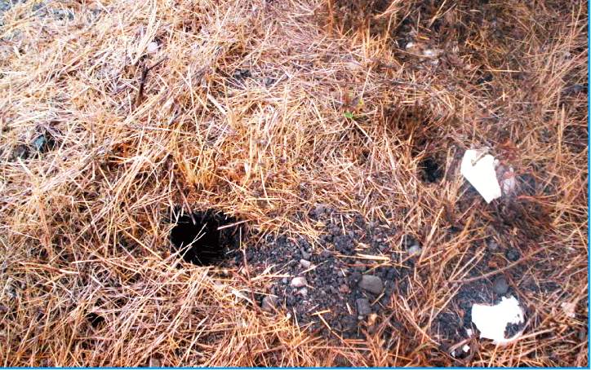
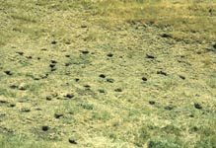
Damage
$30-50 million in agricultural damages to CA annually¹
Compete with grazing animals for forage
Burrows create large holes that are a danger to horses and cattle
Chew on irrigation lines
Burrows can lead to severe erosion of levees, roads and pastures
Known to be carriers of bubonic plague
Notes:
1 – Univ of CA: Ground Squirrel Best Mgmt Practices (Marsh, 1994)
Next slide:
Lets talk about their burrow system

Slide 19
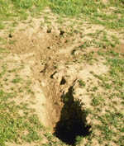
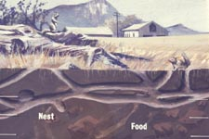
Tunnel / Burrow System
Live in burrow system that may vary in length from 5 ft to more than 35 ft
4 – 5 inch diameter holes
Hillsides or low earth banks are preferred sites so burrows can be excavated horizontally, although many are dug vertically for several feet to assure protection
One burrow system may house many generations , often having multiple openings
Rarely travel farther than 100 ft from burrow
Notes:
Next slide:
What baits are on the market?

Slide 20
Common Bait Types
Kaput-D Ground Squirrel (RUP)
Kaput Ground Squirrel (non-RUP)
Wilco Ground Squirrel (non-RUP) and Ground Squirrel Ag (RUP)
  .0025% Diphacinone + .025% Imidacloprid
  Also targets fleas
  Broadcast or Bait Station
  Within 8 ft of active burrow
  25 lb pail, 50 lb bag
  Oat Groats
  .0025% Diphacinone + .025% Imidacloprid
  Also targets fleas
  Bait Station Required
  Up to 100 ft from buildings
  5 & 25 lb pail, 50 lb bag
  Oat Groats
  .005% Diphacinone
  No flea component
  Bait Station Required
  50 ft from buildings
  4 lb pail, 20 lb & 40 lb bag
  Pelletized
Notes:
Next slide:
Lets talk about the kaput labels

Slide 21
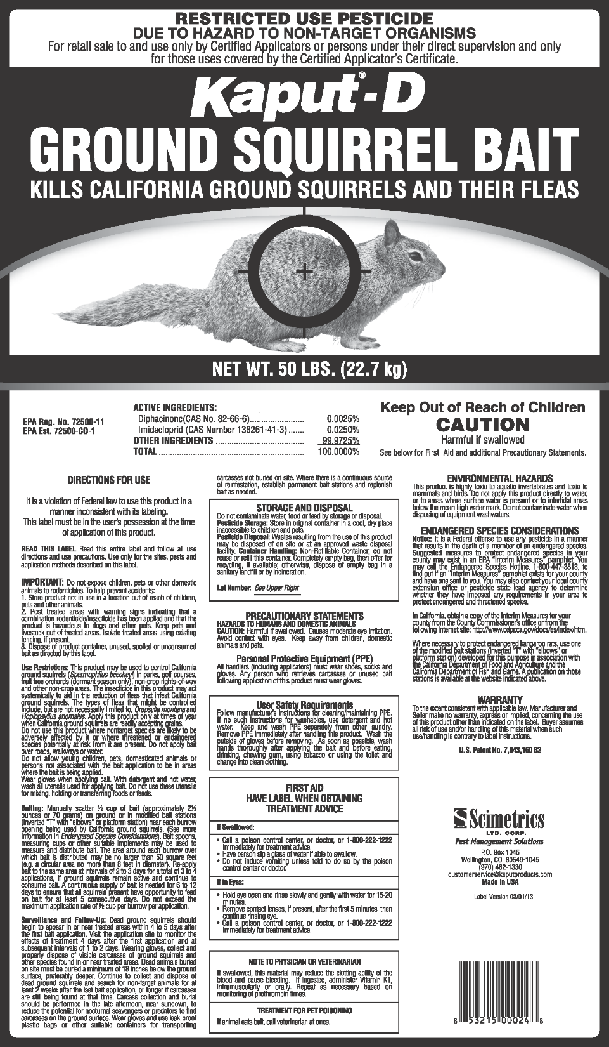
Restricted Use Pesticide
For use in parks, golf courses, fruit orchards (dormant season only), non-crop rights-of-way, non-crop areas
Manually scatter ½ cup of bait on ground or in bait stations near each active burrow
The area of distribution may be no larger than 50 sq ft (8 ft diameter around hole)
Re-apply every 2-3 days for a total of 3-4 applications if needed
Post treated areas with warning signs indicating it has been treated
Keep pets and livestock out of treated areas
Notes:
Next slide:
And non- restricted….

Slide 22
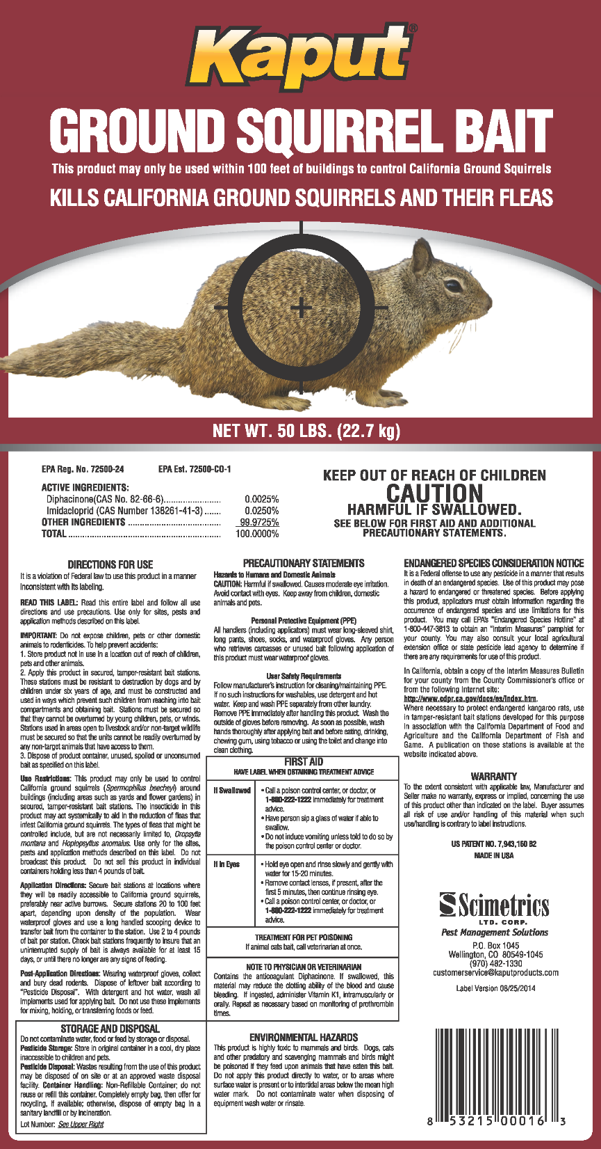
Non-Restricted Use
For use within 100 ft of buildings (including areas such as yards and flower gardens)
Apply only in secured, tamper-resistant bait stations
Use 2 – 4 lbs of bait per station
Check frequently to insure an uninterrupted supply of bait is available for at least 15 days
Notes:
Next slide:
Lets see an example of a pvc bait station you can make

Slide 23
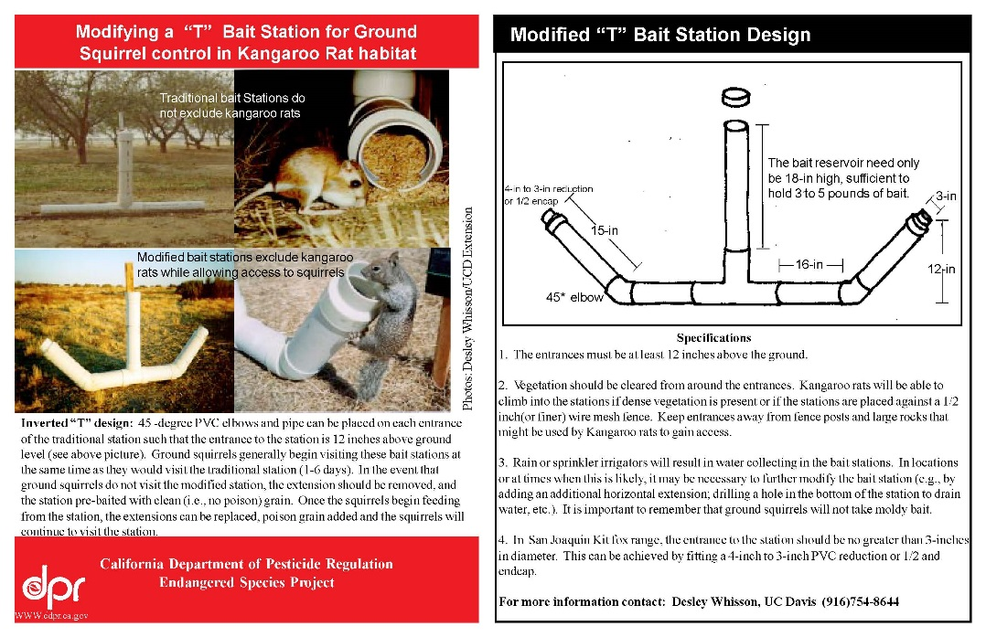
Ground Squirrel Bait Station – Modified “T”
Notes:
Not a great example of “tamper resistant”, but this is what state of CA recommends to exclude kangaroo rats
We are in development process of our own tamper resistant, secured, bait station
Next slide:
Lets talk about the benefits of Imidacloprid

Slide 24
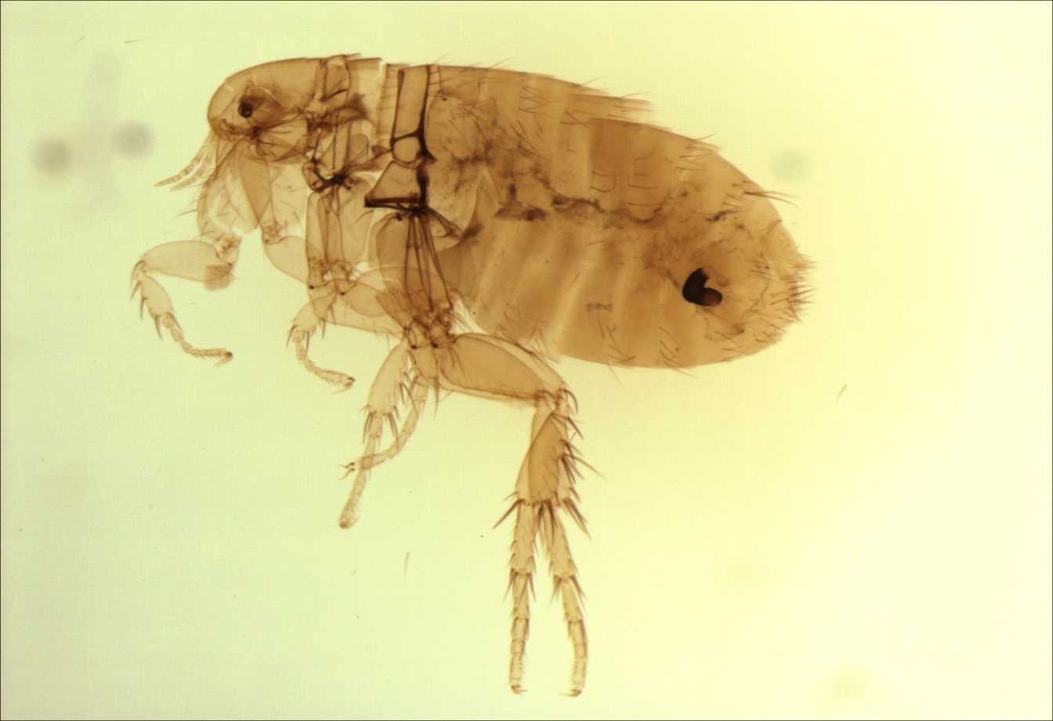
Fleas
common carrier of plague

Slide 25
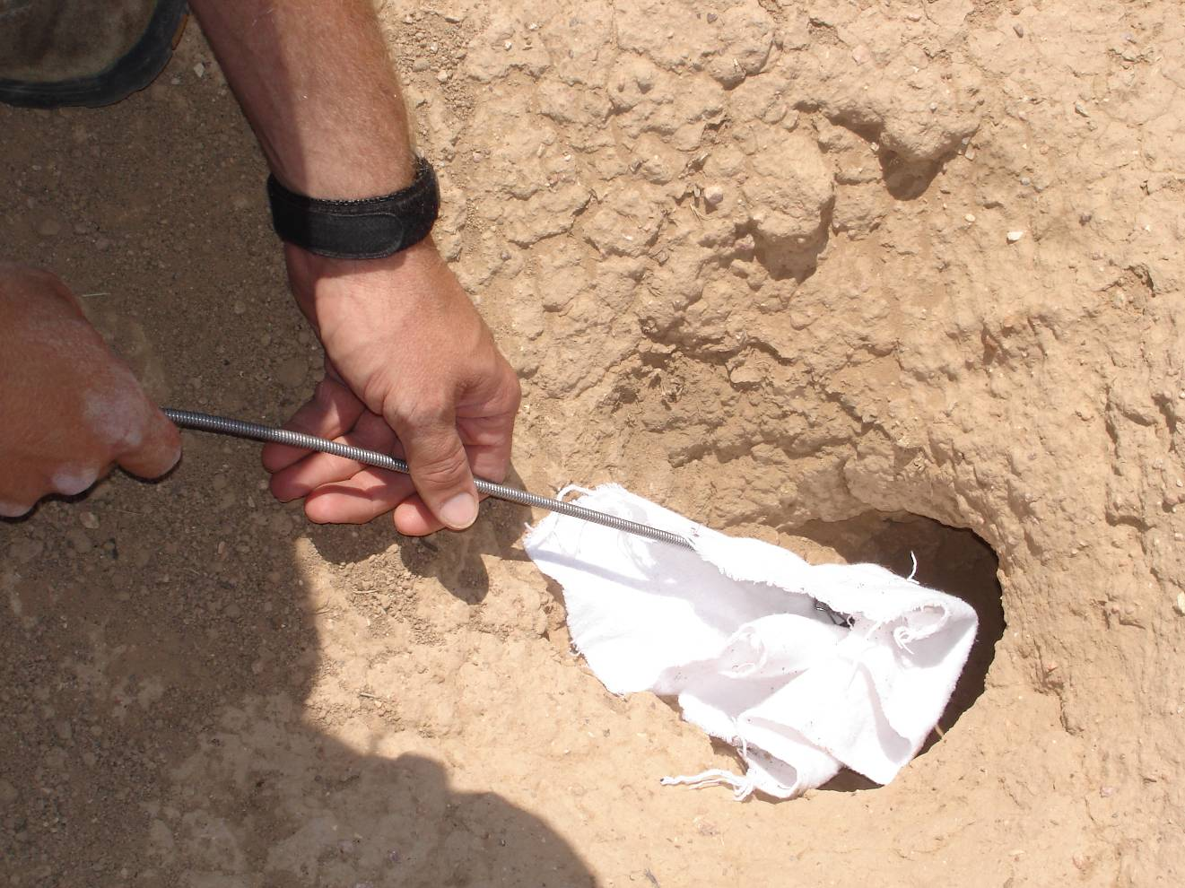
Field Study with Control, Combo Bait,
and Diphacinone Bait Treatments
Two plots of each type
Flea numbers in burrows using flagging 0, 8, 15, 22
Applied ½ cup bait per active burrows
4 applications: 3, 6, 9, 12
Swabbing burrows for fleas

Slide 26
Percent of California Ground Squirrels Infested with Fleas
Using Bait Containing 250 mg/kg Imidacloprid
Plot | Pre Treatment |  | Mid Treatment (Day 15) |  | Post Treatment (Day 29)
 | Date | Flea Infestation (%) | Date | Flea Infestation (%) | Date | Flea Infestation (%)
East Control | 6/7/05 | 88.9 | 6/24/05 | 100 | 7/8/05 | 100
West Control | 6/7/05 | 80.0 | 6/24/05 | 100 | 7/8/05 | 96.3
East Treatment | 6/7/05 | 95.7 | 6/24/05 | 4.2 | 7/8/05 | 0
West Treatment | 6/7/05 | 95.7 | 6/24/05 | 0 | 7/8/05 | 5.0
Notes:
Next slide:
The impact of baiting with active only

Slide 27
Number of fleas near burrow entrances after the use of Combo Bait, no-bait Control Plots, and 0.01% diphacinone (DPN) bait.

Slide 28
Advantages of Kaput Ground Squirrel Bait
Reduced amount of diphacinone (0.0025%) to lower risk to carnivores without affecting efficacy. Others have 0.005% and includes Neogen, Wilco, CDFA. The State of California and Bell Labs have 0.01% dpn, which is 4-times more toxic to wildlife
Contains 0.025% imidacloprid which is systemic and kills fleas feeding on the ground squirrel.
Rodenticide-only products release disease-carrying fleas to find other warm-blooded hosts, such as humans and pets - up to 17,000% increase in fleas.
Allows you to be pro-active with plague control.
Old technology needs to be replaced with a better Public Health tool.
Notes:
Next slide:
So far we have talked about rodents, lets talk about a mammal pest

Slide 29
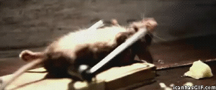
Rat
Mouse
Vole
KAPUT COMBO BAIT PELLETS
KAPUT COMBO BAIT MINI-BLOCKS
KAPUT DOOM
Kaput Rat & Mouse bait
Kaput Mouse blocks
Adios Combo BAIT CUBES

Slide 30
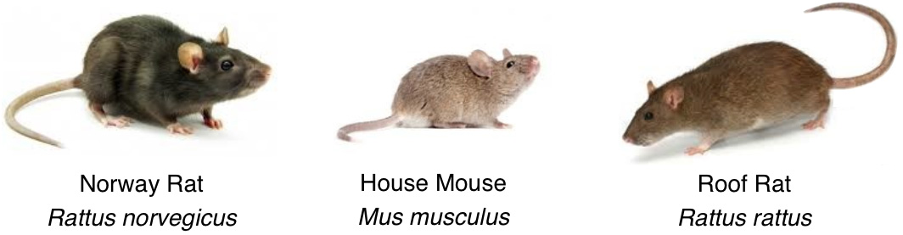
Norway Rat
Prefer basements, cellars & subways
House Mice
Live in close proximity to humans/food source
Roof Rat
Prefers roofs, attics
Tail is shorter in length than body and lighter on bottom
Small ears, large hind feet, blunt muzzle
Primarily brown
Excellent swimmers
12-18” long, 10-17 oz
Tail is shorter or equal length of body
Can ‘tripod’ on hind legs and tail
Primarily feed on plant matter
5-8” long, .4-.9 oz
Can live in trees, likes landscaped areas and riverbanks
Tail is equal length to body and single color
Large floppy ears and pointed muzzle
Adept at climbing
13-18” long, 8-12 oz
Good jumpers, climbers, swimmers

Slide 31
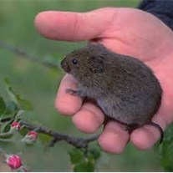
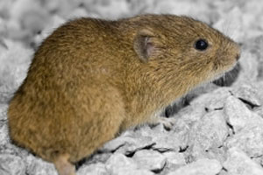
VOLES – Meadow, Pine, Montane
Often mistaken for mice, but have stouter body and shorter, hairy tail
Reproduce VERY rapidly, capable of first litter at 3 weeks of age, another possible every 3 weeks after
A single vole can birth 100+ voles in a year
Primarily herbivores
Live in burrow system with many entrance/exit holes which can be mistaken for gopher or ground squirrel systems

Slide 32
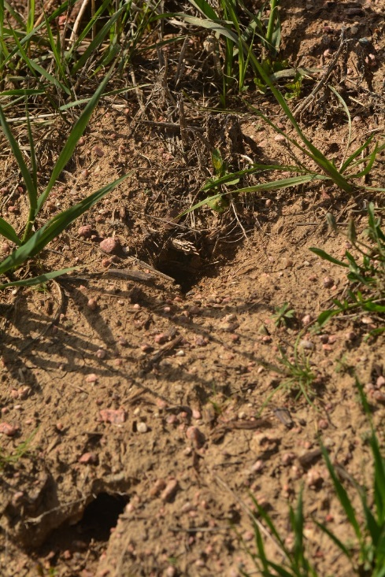
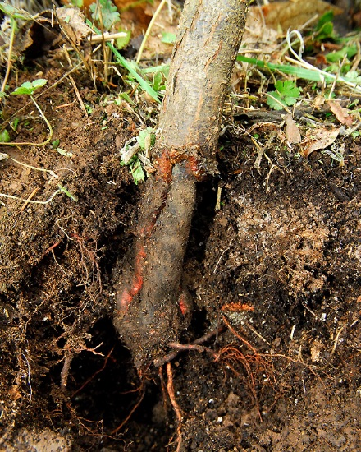
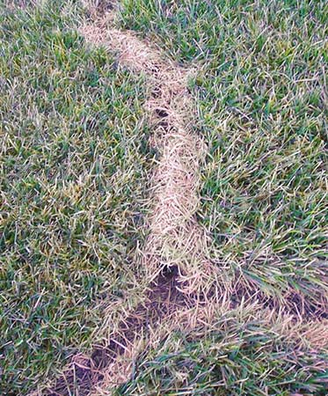
Vole Damage
Extensive surface trails, sometimes creating visible ridges
Damage trees, shrubs, bulbs, and perennials from below the ground, consuming small roots, girdling large roots, and eating the bark from the base of small trees
Extensive turf damage caused by shallow tunnels and consuming grass roots

Slide 33
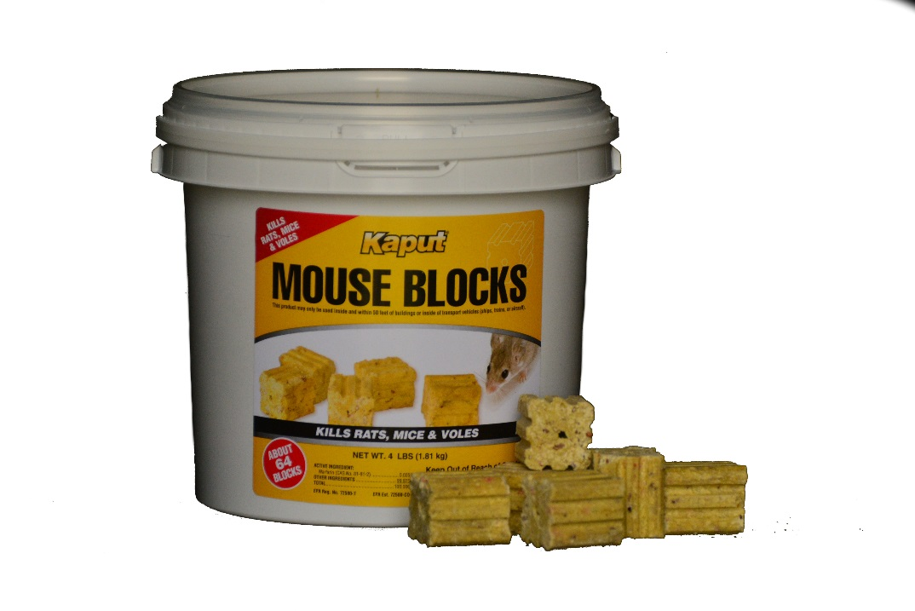
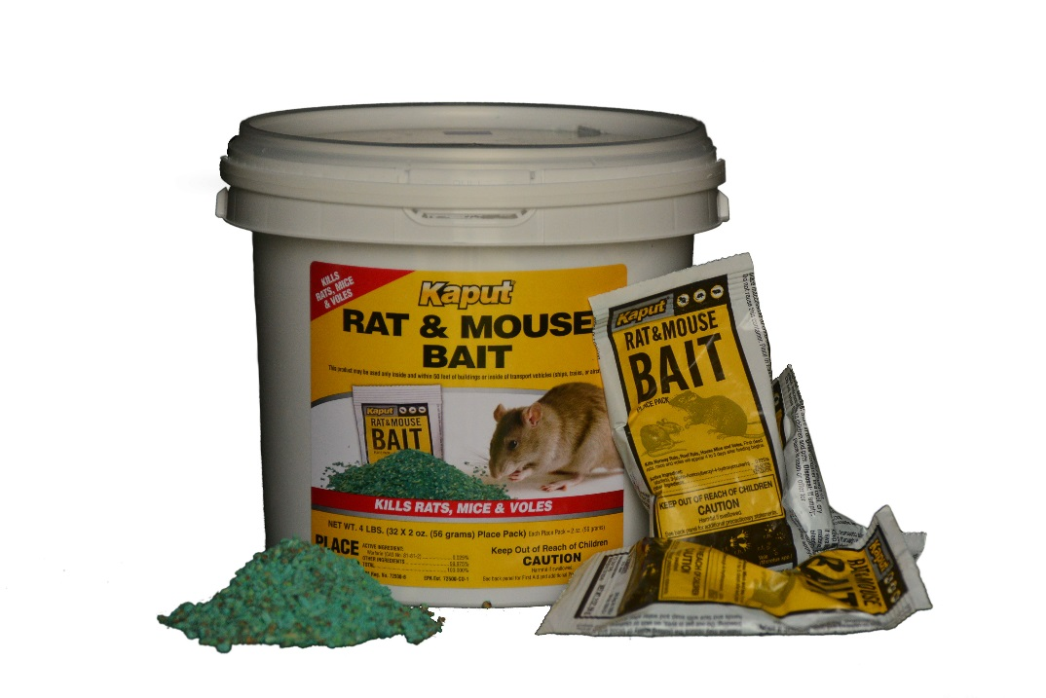
Baits for Rats, Mice and Voles
Rats: 4-16 blocks, 15-30 ft intervals
Mice: 1-2 blocks, 8-12 ft intervals
Voles: 1 block in bait station
Warfarin
Maintain uninterrupted supply of bait for at least 15 days
Rats: 2-8 placepacks, 15-30 ft intervals
Mice: ¼ - ½ oz, 8-12 ft intervals
Voles: 1 oz (½ pack) in bait station
Warfarin
Maintain uninterrupted supply of bait for at least 15 days

Slide 34
Common Rodent-borne Diseases
in the United States
Plague: 10-20 cases each year
Lyme Disease: 27,000+ confirmed cases in 2013
Leptospirosis: (transmitted by the urine of an infected animal and is contagious as long as it is still moist. Although rats, mice and moles are important primary hosts, a wide range of other mammals are able to carry and transmit the disease as secondary hosts.)
Infections on the rise in children in urban areas
Salmonella: much more common than led to believe – 40,000 cases per year but since milder cases are not reported could be 30x higher
Hantavirus: 2008 24 cases, 50% mortality
2010 21 cases, 29% mortality
2013 21 cases, 43% mortality
Some 50+ others

Slide 35
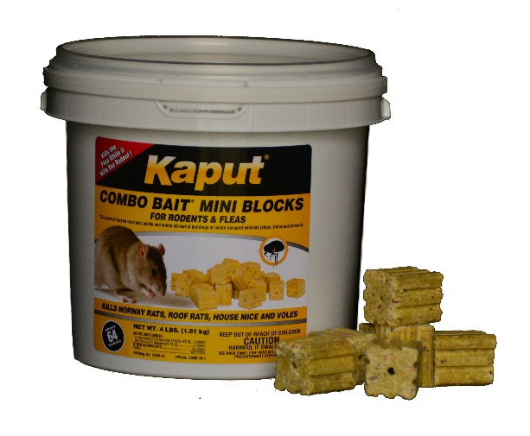
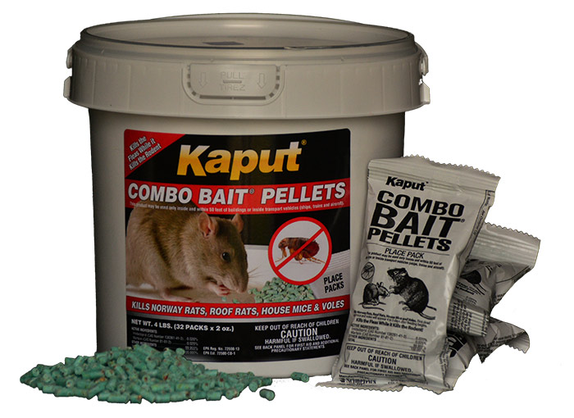
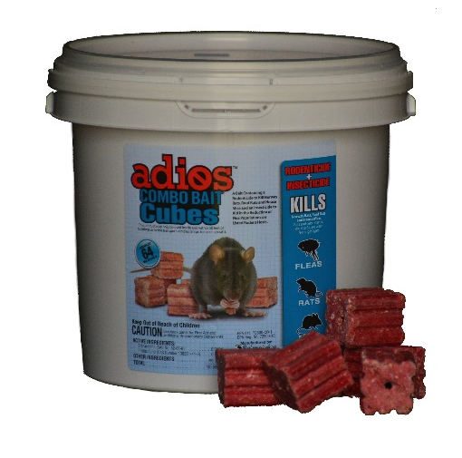

Kaput Combo Baits
The ONLY baits of their kind in the world
Include the insecticide Imidacloprid to also kill the fleas on the rodent
Reduces the spread of flea-borne disease

Slide 36

Baits for Rats, Mice, Voles AND Fleas
Rats: 4-16 blocks, 15-30 ft intervals
Mice: 1-2 blocks, 8-12 ft intervals
Voles: 1 block in bait station
Warfarin + Imidacloprid
Maintain uninterrupted supply of bait for at least 15 days
Rats: 2-8 placepacks, 15-30 ft intervals
Mice: ¼ - ½ oz, 8-12 ft intervals
Voles: 1 oz (½ pack) in bait station
Warfarin + Imidacloprid
Maintain uninterrupted supply of bait for at least 15 days

Slide 37


Baits for Rats, Mice AND Fleas
Rats: 3-15 blocks, 15-30 ft intervals
Mice: 1-2 blocks, 8-12 ft intervals
Diphacinone + Imidacloprid
Maintain uninterrupted supply of bait for at least 15 days
Rats: 4-16 blocks, 15-30 ft intervals
Mice: 1-2 blocks, 8-12 ft intervals
Bromadialone + Imidacloprid
Maintain uninterrupted supply of bait for at least 15 days

Slide 38

Poultry Rotation Program
3 Bait Rotation with Insecticide
Kaput Combo Bait Mini-Blocks
Adios Combo Bait Cubes
Kaput Doom

Slide 39

Days to Death in House Mice
39

Slide 40


Kaput EZ Bait Box
Heavy Duty Construction
Tamper Resistant
Notes:
So now you know all about our current baits. Lets talk about an exciting new bait currently in development

Slide 41
Thank You
For Your Time

